Slide 1

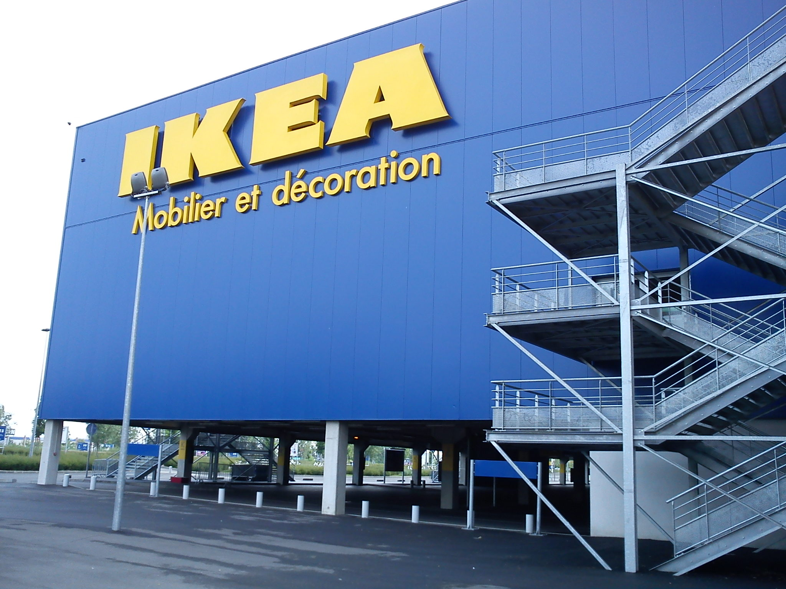
Integrity Moments
Case Overview:
IKEA France Spying Scandal

Slide 2


Case overview
IKEA France illegally spied on employees, customers, and job applicants.
Key fact
Impact
IKEA France was fined €1 million for this breach of privacy
Legal actions and reputation damage

Slide 3

Are you respecting the privacy of your employees, customers, and partners in all your actions?
Is the leader leading by example? Do their actions align with the ethical values that they expect from their team?
Reflection questions

Slide 4
Integrity Issues
IKEA France Spying Scandal
Privacy: IKEA violated privacy laws, breaching employee and customer trust.
Abuse of Power: Senior executives approved unethical practices.
Reputation: Trust was damaged between IKEA and its workforce.

Slide 5

Are you being transparent about the reasons behind your decisions and actions with your employees and stakeholders?
Are you handling sensitive information with confidentiality and care?
Reflection questions

Slide 6
Consequences
IKEA France Spying Scandal
Outcome: IKEA France fined €1 million; executives received fines and suspended sentences.
Risk: Long-term reputational damage and legal penalties.

Slide 7






Related SDGs
IKEA France Spying Scandal
Unethical work conditions created a hostile environment
Surveillance discriminated against employees
Violating privacy reflects unethical corporate behavior

Slide 8

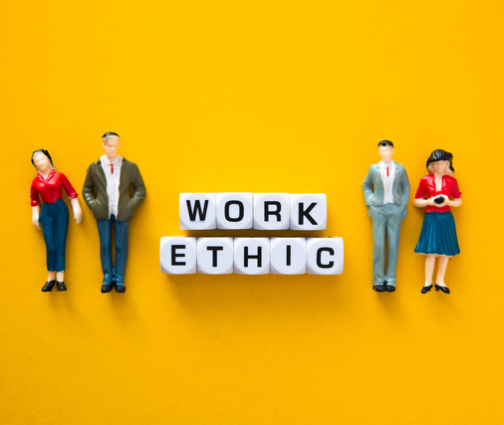

Key Learnings
IKEA France Spying Scandal
Privacy:
Adhering to GDPR and privacy laws is critical to corporate reputation.
Ethics:
Unjust surveillance erodes trust and employee morale.
Leadership:
Executives must be held accountable for ethical lapses.

Slide 9

From your observation, do employees in your organization feel safe speaking up if they notice unethical practices?
If your company conducted surveillance of employees, would you be willing to share it on LinkedIn? If not, why?
Reflection questions

