Slide 1

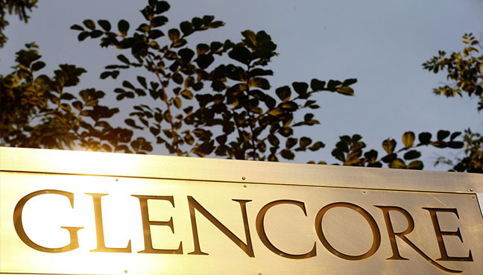
Integrity Moments
Case Overview:
Glencore Energy UK Ltd. Bribery Scandal

Slide 2


Case overview
Glencore's traders engaged in long-term bribery schemes in West Africa, bribing officials to gain profits.
Key fact
Impact
Glencore pleaded guilty to seven counts of bribery in June 2022
Paid £280 million in fines and penalties

Slide 3

How does your company ensure transparency in financial transactions and third-party payments?
Are your employees aware of and trained on anti-bribery and anti-corruption policies?
Reflection questions

Slide 4
Integrity Issues
Glencore Energy UK Ltd. Bribery Scandal
Corruption: Bribery normalized within Glencore's West Africa desk.
Third-party risks: Payments disguised as legitimate expenses through agents.
Consequences: Significant financial and reputational damage.

Slide 5

What processes do you have for vetting new partners, suppliers, or contractors?
Do you assess the integrity of your business partners and avoid working with those involved in unethical practices?
Reflection questions

Slide 6
Consequences
Glencore Energy UK Ltd. Bribery Scandal
Outcome: Glencore fined £280 million for bribery.
Risk: Widespread reputational harm and corporate accountability.

Slide 7

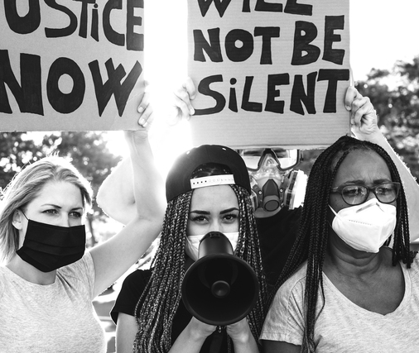

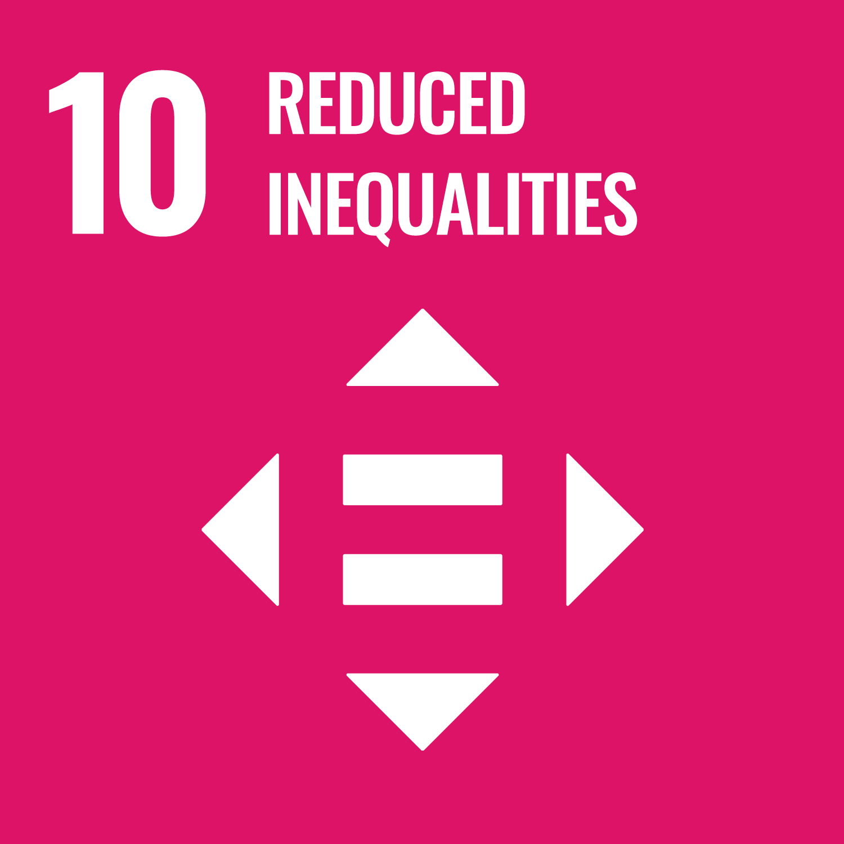


Related SDGs
Glencore Energy UK Ltd. Bribery Scandal
Reduced inequality affected by corrupt practices.
Peace, Justice, and Strong Institutions.
Partnerships for global anti-corruption.

Slide 8



Key Learnings
Glencore Energy UK Ltd. Bribery Scandal
Ethics:
Strong leadership is essential to prevent corruption.
Controls:
Financial oversight can prevent disguised bribery.
Due diligence:
Ensure all agents and partners are vetted.

Slide 9
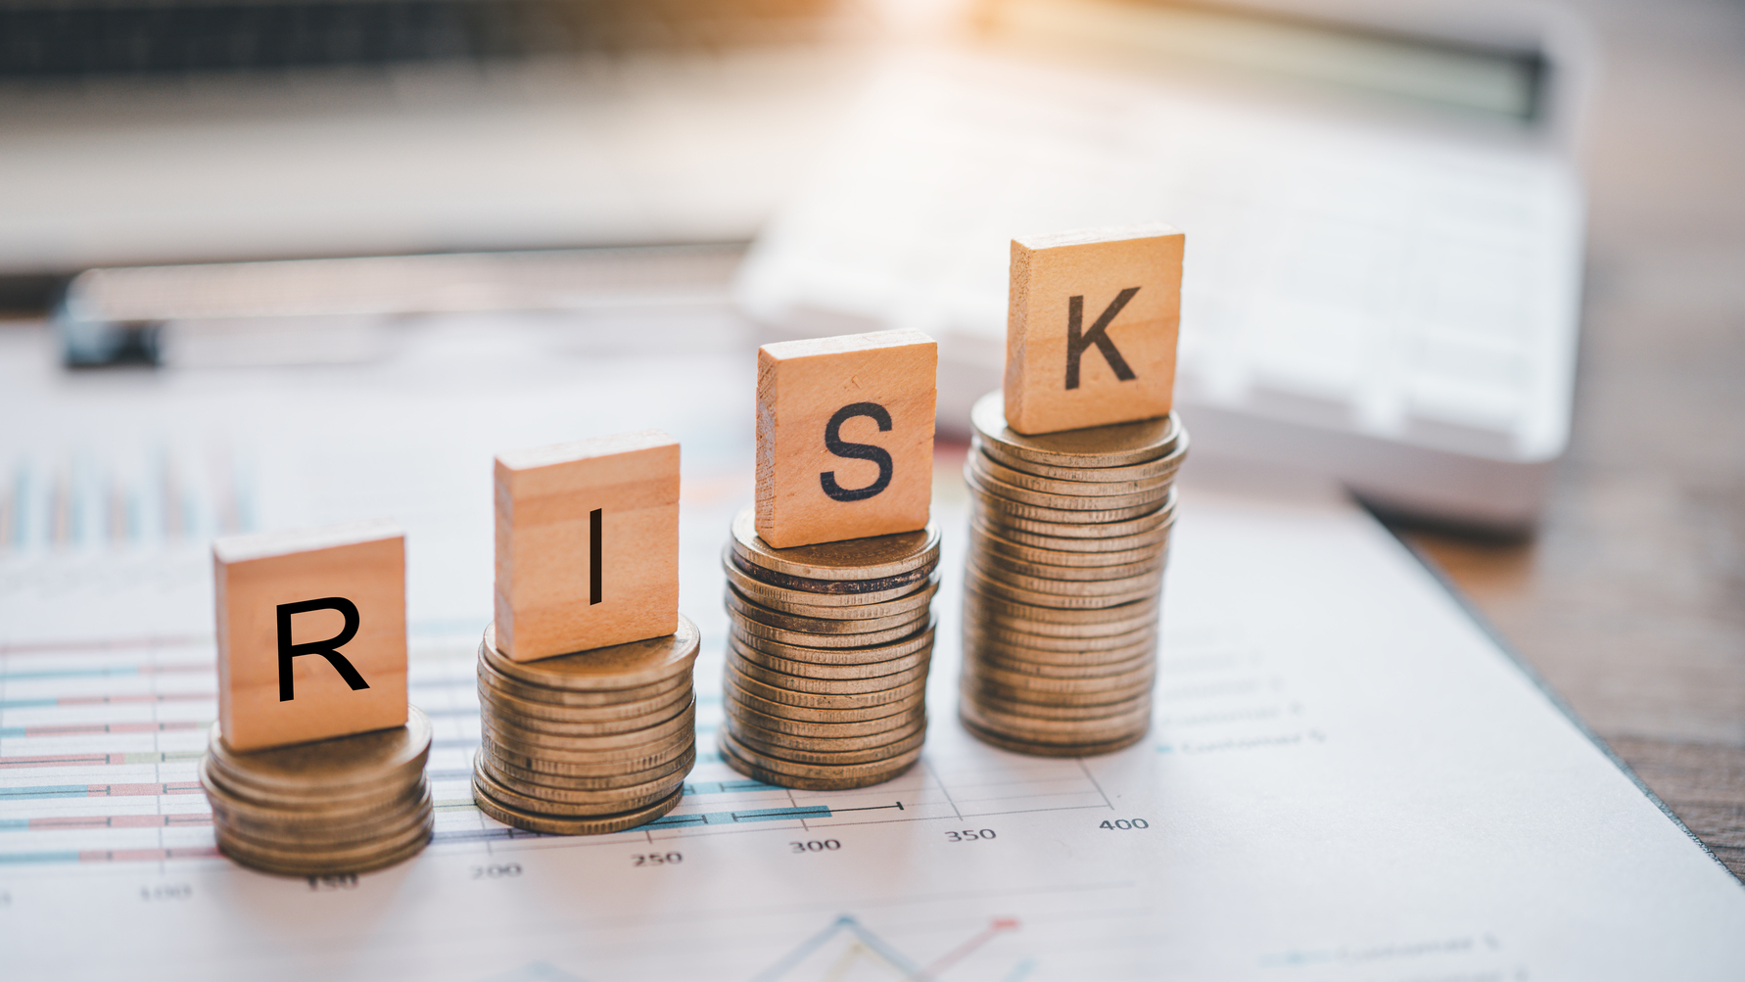
How do you manage operations in high-risk markets or regions with known corruption risks?
Have you conducted your activities in a manner that upholds the highest ethical standards, even if laws don’t explicitly require them?
Reflection questions

